Slide 1

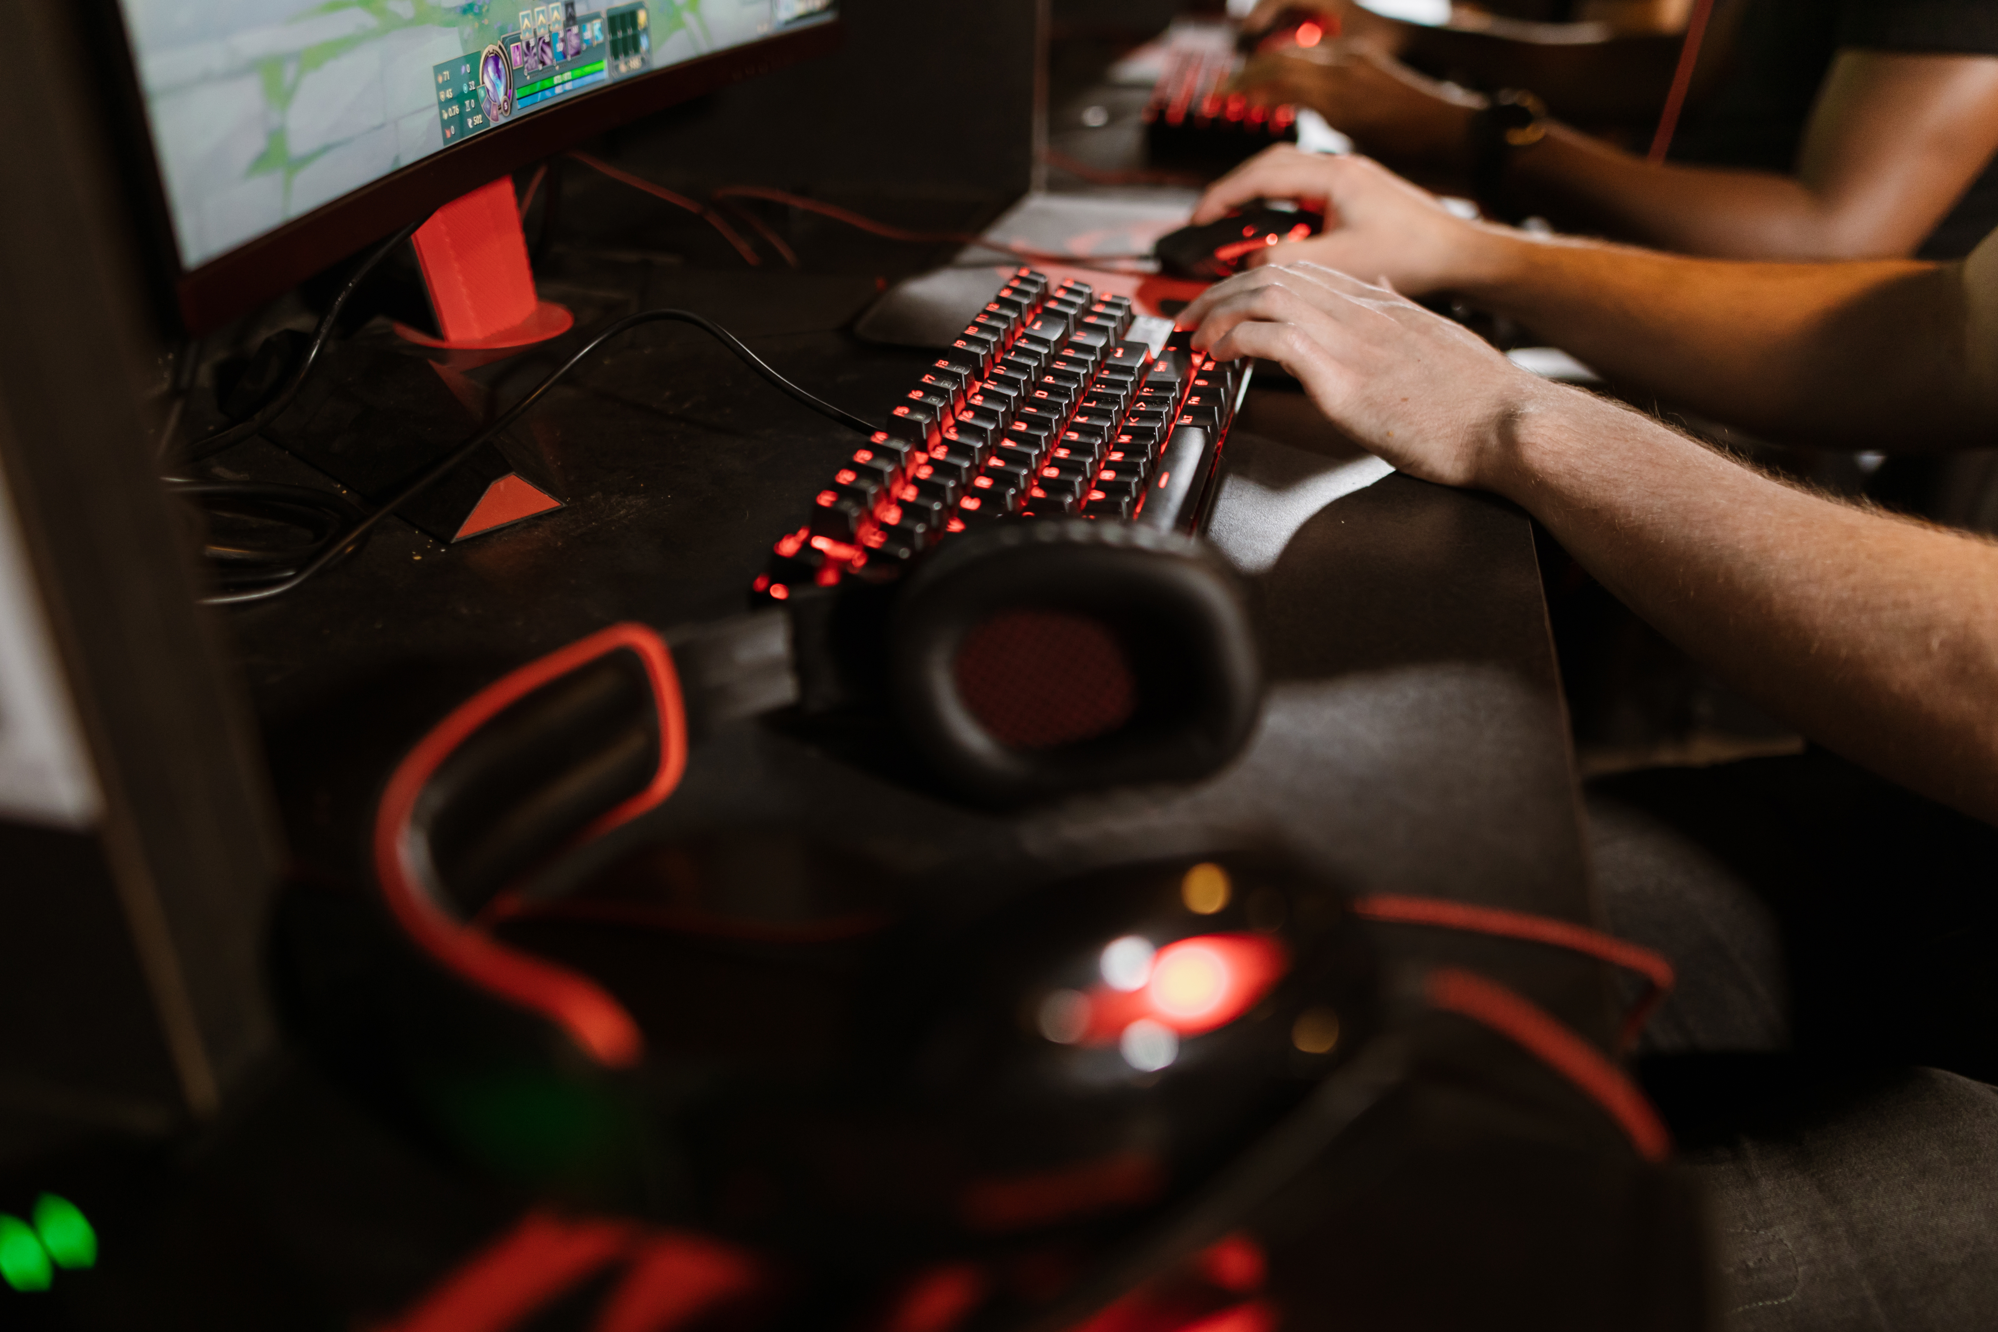



SYSTEM MANAGEMENT
ALTERNATE
– AN ELECTRONICS WEBSITE
PRESENTED TO YOU BY:
GROUP Ctrl + Alt + Delete

Slide 2




OUR GROUP
MEMBERS
Front-End Developer
Back-End Developer
Content Creator
TAN TING WEI
CHOO YI
NG WEI JIAN

Slide 3

GET TO KNOW
ALTERNATE
Alternate is an online website where you can buy gaming accessories such as mouse, mousepad, keyboards, headphones, etc.
It’s main objective is to provide an ALTERNATE platform for computer users to buy gadgets.
Behind the design and content:
We provide a dark and light theme to improve the users experience. In this 21th-century, people want to buy computers accessories and gadgets that suits their style and with cheap prices, so here we are, with ALTERNATE.

Slide 4

WHAT MAKES US
SPECIAL
We stay update with the recent gaming trends.
We made it easy for users to use the website. For instance, user can check their shopping cart and choose the quantity they want.
As a website that sells EVERY gaming accessories/gadgets, we categorized them very well for users to find what they want easier
We keep track every item’s stock too!

Slide 5
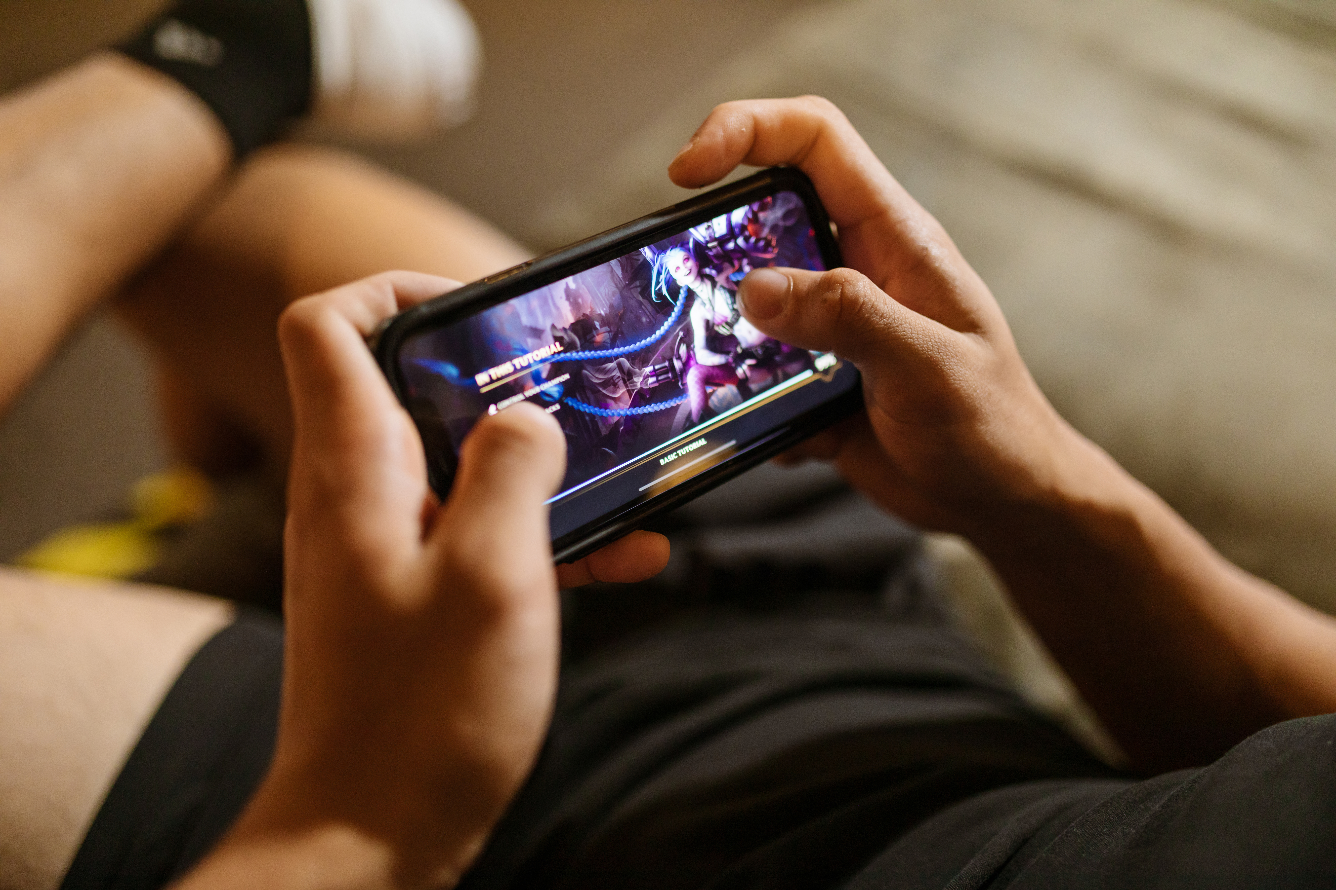

INSPIRATION
The website Alternate is inspired by Razer™, the world’s leading lifestyle brand made For Gamers. By Gamers.
OUR
INSPIRATION & BACKGROUND
BACKGROUND
We wish to create an alternate platform for fellow gamers to buy from. With more offers and products from many big companies, we hope every users can find the item that satisfies the requirements for them. We believe in that “Life’s Simple” and it motivates us to make other’s life more simple.

Slide 6

TARGET
AUDIENCE
GAMING CONTENT CREATORS AND STREAMERS
(AGES 18–30)
CASUAL GAMERS (AGES 16–40)
They’re drawn to trendy, visually appealing accessories (e.g., RGB headsets, themed mousepads) and budget-friendly options. X users often share setups with aesthetic gear, showing this group values style.
X posts highlight creators showcasing their setups or unboxing gear, driving trends. They influence their followers’ purchasing decisions, making them key for partnerships.

Slide 7


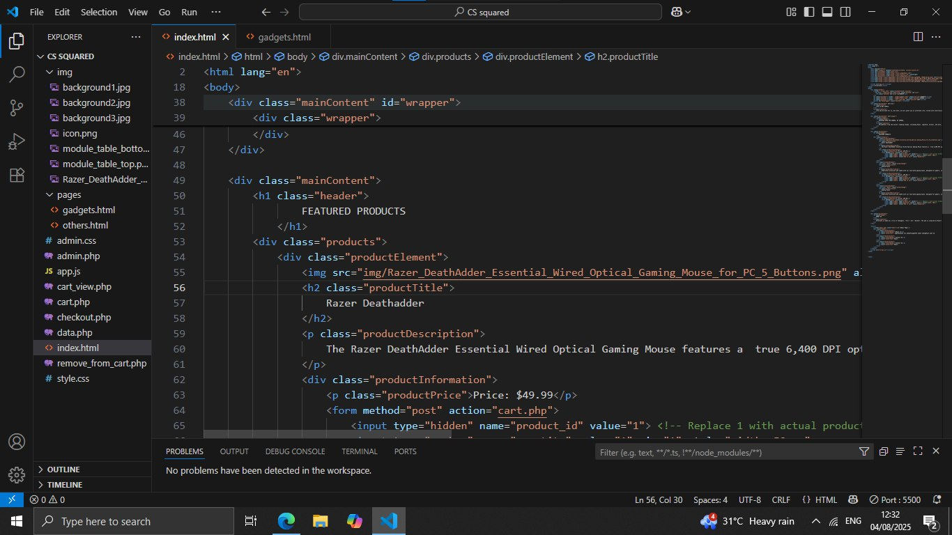
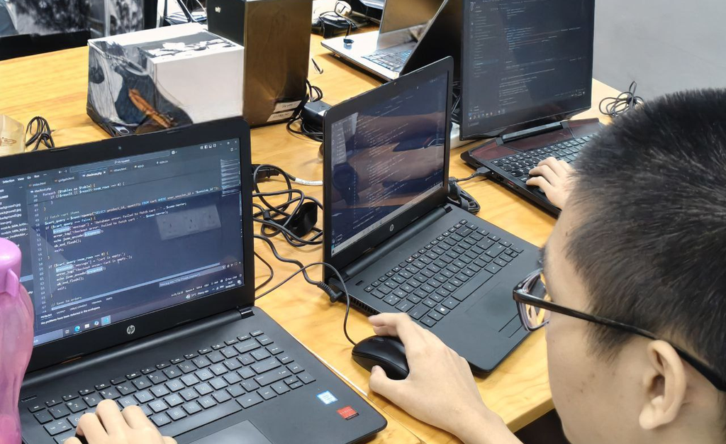



TOOLS AND
TECHNOLOGIES
The website uses the programming language
HTML, CSS, JavaScript, PHP and SQL. We mainly used
Visual Studio Code and GitHub for the website.

Slide 8
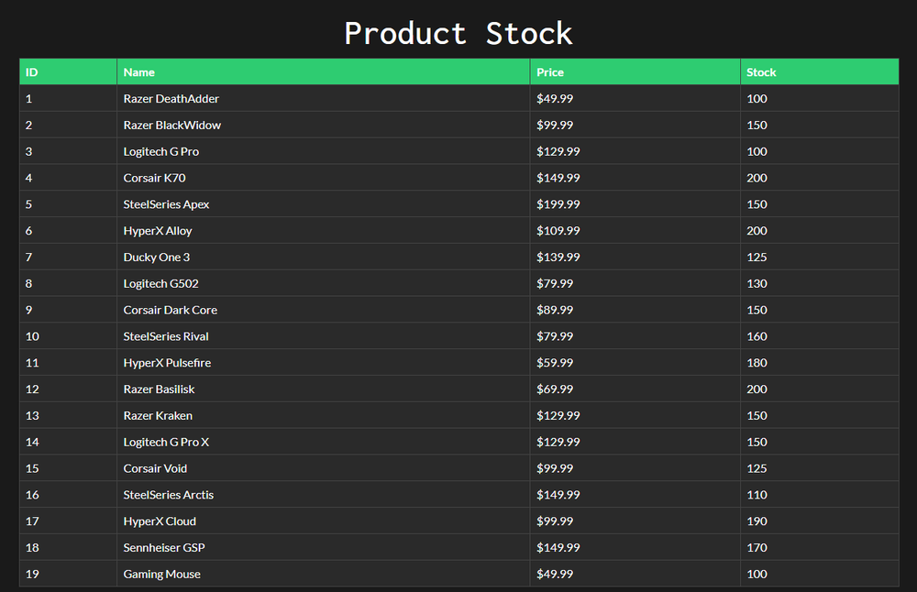


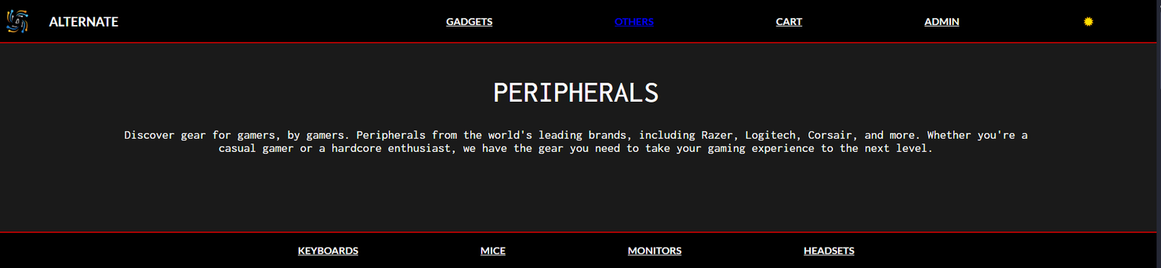
Light mode and Dark mode
Keeping track of product’s stock
KEY
FEATURES
User-Friendly Interface and Navigation

Slide 9
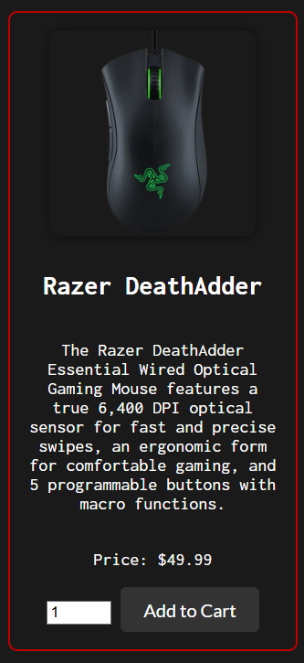
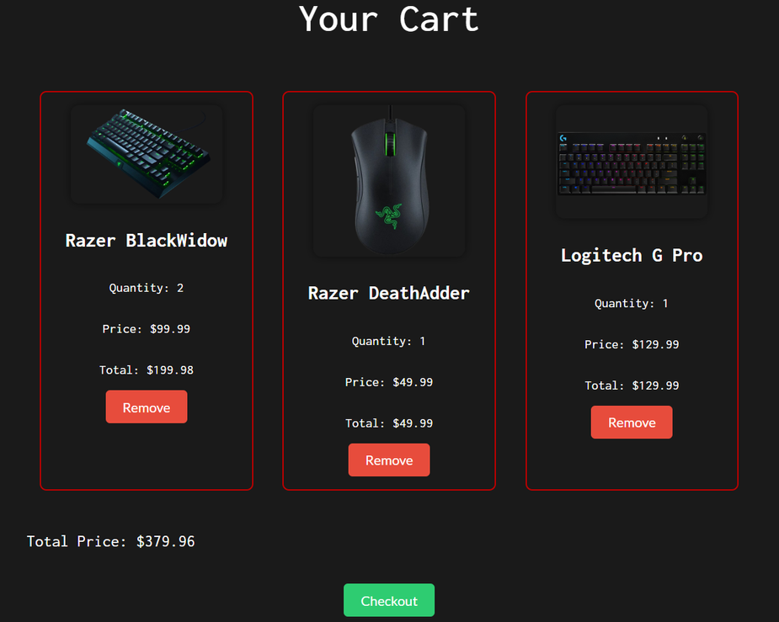
KEY
FEATURES
Able to choose quantity
Shopping cart feature

Slide 10

ENHANCEMENTS
IN THE FUTURE
Able to use admin page to upload products instead of uploading products via coding.
Able to make payment.
Make a user login page
Admin page is hidden from users

Slide 11










THANK
YOU
IMAGES FROM:
SPECIAL THANKS TO:

